Slide 1
Customer Segmentation
and
Sale’s Prediction
Capstone Project Proposal
Tiru Wube
Wale Agboola

Slide 2
Introduction
What is it about?
Customer/Wholesaler segmentation and sales prediction
Relying on retail analytics and raw data rather than guesswork enables you to make smarter decisions toward higher profits, better customer satisfaction, and having a more successful business overall. Over the years retail data has become increasingly important and vital for organizations to keep ahead of their competitors and keep increased levels of customer retention.
Why is this project chosen?
Test our strengths and weaknesses in Natural Language Processing and how we can apply it to this specific dataset.
We both had interest in retail data.
It is something we come across many times a week without realizing most of the time.
Provide product suggestions for the customer based on the customers spending habits and their product categorization history.

Slide 3
What is the research question/hypothesis?
Given the segmented product categories using NLP and LDA, does the most frequent product category equate to the highest total sales throughout the year?
With our results, can we provide product suggestions based on order history and time of the year?
Things we could also look into given that we have enough time..
Which cluster of RFM value would bring the highest total sale the following year?
Market Basket Analysis.

Slide 4
Models we plan on implementing:
LDA Topic Modeling (Latent Dirichlet allocation)
Categorize products/entries based on their product description.
See what categories of products do well in different times of the year.
Sale’s prediction
The data was collected from 2009 to 2011, the model will be trained using 2009 and 2010 data and predict the 2011 sale of a certain product category and evaluate the model how it performs.
Will specific product categories have higher sales depending on the time of the year?

Slide 5
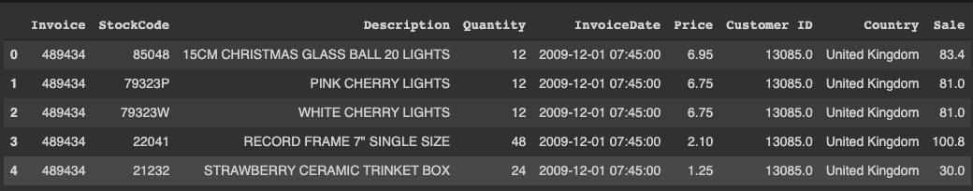
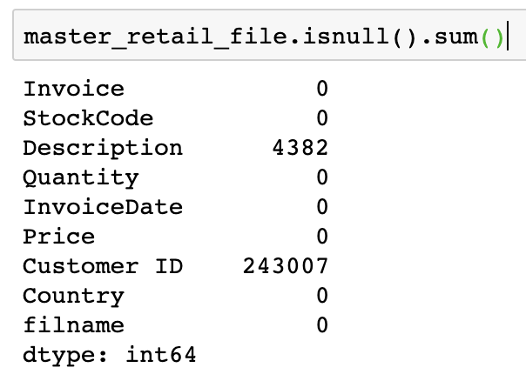
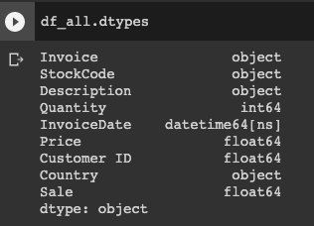
Data
This Online Retail II data set contains all the transactions occurring for a UK-based and registered, non-
store online retail between 01/12/2009 and 09/12/2011.The company mainly sells unique all-occasion giftware. Many customers of the company are wholesalers.
Data file currently holds 1,067,371 records with 8 features(columns)
1 customer can have multiple invoices (transactions)
Features include…
Invoice
Stock Code
Description
Quantity
Invoice Date - Split into two columns one “Date” & “Time”
Price
Customer ID
Country
Sales
Data source: https://archive.ics.uci.edu/ml/machine-learning-databases/00502/
How do we handle NULL values? Options include..
Drop NULL values in “Description” column since they’re aren’t that many
Fill “Customer ID” NULL values with ‘0’
Fill “Customer ID” NULL values with ID numbers that correspond to the invoice number.

Slide 6
Similar papers
Data mining for the online retail industry: A case study of RFM model-based customer segmentation using data mining: Chen, D. Sain, S.L., and Guo, K. (2012) RFM Model based customer segmentation
K Means clustering (sensitive to data that has outliers)
Decision Tree Model
Separated Invoice Date into two column Date and Time
Sorted Dataset by postal code
Used SAS programing language (used for statistical analysis)
Data is used from 2010-2011 shortening the total amount of entries
Dropped their NULL value entries

Slide 7
Similar papers and what makes ours different (cont…)
Predicting customer profitability over time based on RFM time series: Chen, D., Guo, K. and Ubakanma, G. (2015)
They treated wholesalers as individual customers*
Used multi layered feed forward neural network Models( Trained to capture the dynamics of evolving customer profitability)
Focused solely on prediction
Dropped NULL Value entries

Slide 8
What makes our project different?
LDA Topic Modeling
Entries will be categorized/sorted into specific product categories
Data set has been changed based on previous papers. Current dataset uses mostly “wholesaler” transaction data not individual customer data
Will use python for our modeling, no SAS
We may incorporate Tableau for our visualizations, make things easier to decipher overall*
Current Dataset is from 2009-2011, increasing the total amount of entries we have to work with
Using product categorization to somehow predict future sales (Incorporate and combine product segmentation and sales prediction)*
Dropping “Description” column NULLs and filling “Customer ID” NULLs with 0
Explain why product categorization/clustering is very relevant in retail data
ML algorithms/Regression models

Slide 9
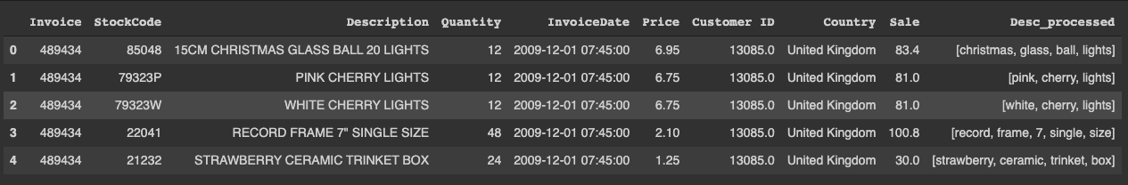
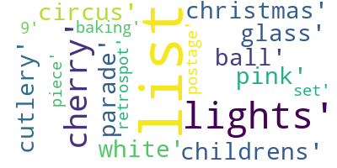
Exploratory Data Analysis
Screenshot of data frame above shows a cleaned version of the “Description” column void of any characters that may skew our findings. New column is Desc_processed.
Word Cloud - Most frequent words are in bold and larger size while less frequent words are smaller fonts. Words from “Description” column are depicted.

Slide 10
Reference:
Chen, D. Sain, S.L., and Guo, K. (2012), Data mining for the online retail industry: A case study of RFM model-based customer segmentation using data mining, Journal of Database Marketing and Customer Strategy Management, Vol. 19, No. 3, pp. 197-208. https://link.springer.com/article/10.1057/dbm.2012.17
Chen, D., Guo, K. and Ubakanma, G. (2015), Predicting customer profitability over time based on RFM time series, International Journal of Business Forecasting and Marketing Intelligence, Vol. 2, No. 1, pp.1-18. https://www.inderscienceonline.com/doi/abs/10.1504/IJBFMI.2015.075325

